Slide 1
INTRODUCTION TO DATA STRUCTURES

Slide 2
Reference Books
Ellis Horowitz, Sartaj Sahni, Dinesh Mehta, Fundamentals of Data Structures in C++ (2e), Galgotia Publications, 2008.
Mark Allen Weiss, Data Structures and Algorithm Analysis in C++ (3e), Pearson Education, 2009.
Michael T. Goodrich, Roberto Tamassia, David Mount, Data Structures and Algorithms in C++ (2e), John Wiley & Sons, 2011.
Ellis Horowitz, Sartaj Sahni, Susan Anderson-Freed, Fundamentals of Data structures in C (2e), Silicon Press, 2008.

Slide 3
Basic Terminologies
Data: are simply a value or a set of values of different or same type which is called data types like string, integer, char etc.
Structure: Way of organizing information, so that it is easier to use

Slide 4
Data Structure
In simple words we can define data structures as
It is a way of storing and organizing data in such a way that it is easier to use.
A data structure is a particular way of storing and organizing data in a computer so that it can be used efficiently in programs or algorithms.
A scheme for organizing related pieces of information.

Slide 5
Algorithm
Set of instructions which work on the data structure to solve a particular problem

Slide 6




Example
2km
7km
 | home | Mall | shop | school
home | 0 | 5 | 2 | 9
Mall | 5 | 0 | 6 | 8
shop | 2 | 6 | 0 | 7
school | 9 | 8 | 7 | 0
6km
5km
8km

Slide 7
Example
2km
7km
 | home | Mall | shop | school
home | 0 | 5 | 2 | infinity
Mall | 5 | 0 | 6 | 8
shop | 2 | 6 | 0 | 7
school | infinity | 8 | 7 | 0
6km
5km
8km
What is the shortest distance between home and school?

Slide 8
Algorithm to answer question
Home to school direct path does not exist according to our convention
So calculate the distance to school from home via shop
Calculate the distance to school from home via mall
Find smallest distance among these 2

Slide 9
Why study data structure and algorithms
You know computer is a data processor. Without storing and knowing how to store data in different ways how u will process?
How u will decide which approach is better ?
How u will decide what data structure to use?
Which processing method should be used?
……………..
So, It is very very important to know data structures

Slide 10
MCQ’s
The meaning of data is
A. array B. values C. organization D. Integer
The meaning of structure is
A. Storing B. Organizing C. Different ways D. None of these
Float is -----------
A. Value B. data type C. both A and B D. none of these

Slide 11
Classification of Data Structure ...
Simple Data Structure: Simple data structure can be constructed with the help of primitive data types.
- A primitive data structure used to represent the standard data types of any one of the computer languages (integer, Character, float etc.).
Compound Data Structure: Compound data structure can be constructed with the help of any one of the primitive data structure and it is having a specific functionality.
- It can be designed by user. It can be classified as Linear and Non-Linear Data Structure.

Slide 12
Another way of classification
Linear Data Structures: A linear data structure traverses the data elements sequentially, in which only one data element can directly be reached.
Ex: Arrays, Linked Lists
Non-Linear Data Structures: Every data item is attached to several other data items in a way that is specific for reflecting relationships. The data items are not arranged in a sequential structure.
Ex: Trees, Graphs

Slide 13
Data Structure
Primitive data structure
Compound data structure
integer
float
character
pointer
Linear data structure
Non-Linear data structure
Array
Linked list
stack
queue
tree
graph
files

Slide 14
Types of Data Structure
Array: is commonly used in computer programming to mean a contiguous block of memory locations, where each memory location stores one fixed-length data item. e.g. Array of Integers int a[10], Array of Character char b[10]
Array of Integers
0 | 1 | 2 | 3 | 4 | 5 | 6 | 7 | 8 | 9
5 | 6 | 4 | 3 | 7 | 8 | 9 | 2 | 1 | 2
Array of Character
0 | 1 | 2 | 3 | 4 | 5 | 6 | 7 | 8 | 9
5 | 6 | 4 | 3 | 7 | 8 | 9 | 2 | 1 | 2

Slide 15
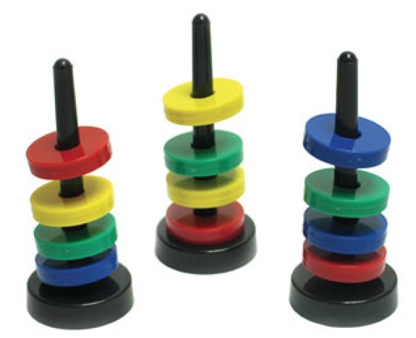
Types of Data Structure
Stack: A stack is a data structure in which items can be inserted only from one end and get items back from the same end.
The last item inserted into stack, is the first item to be taken out from the stack.
It is also called Last in First out [LIFO].

Slide 16
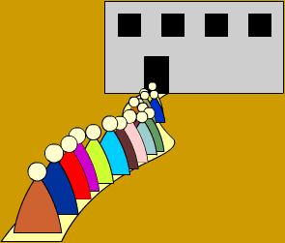
Types of Data Structure
Queue: A queue is two ended data structure in which items can be inserted from one end and taken out from the other end.
Therefore, the first item inserted into queue is the first item to be taken out from the queue.
This property is called First In First Out [FIFO].

Slide 17
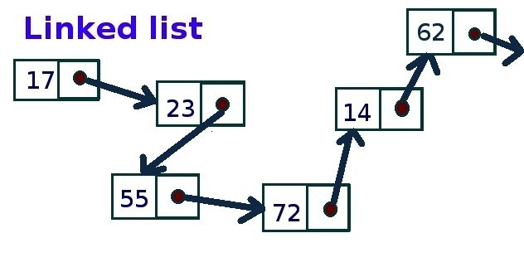
Types of Data Structure
Linked List: Could alternately used to store items.
In linked list, space to store items is created as is needed and destroyed when space no longer required to store items.
Hence linked list is a dynamic data structure space acquire only when need

Slide 18
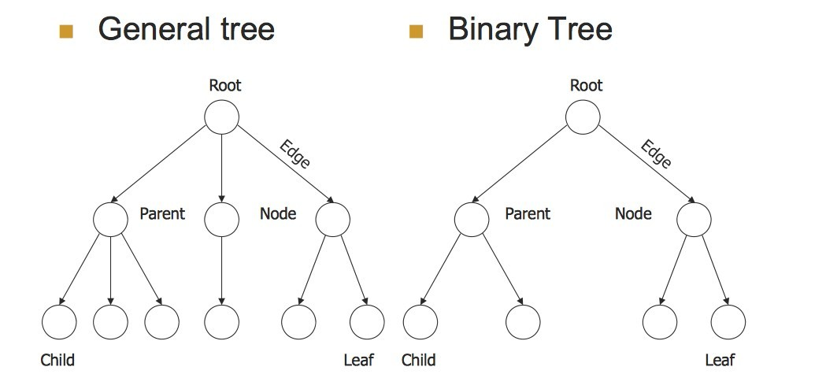
Types of Data Structure
Tree: is a non-linear data structure which is mainly used to represent data containing a hierarchical relationship between elements.
- Binary Tree: A binary tree is a tree such that every node has at most 2 child and each node is labeled as either left of right child.

Slide 19
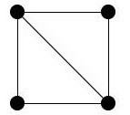
Types of Data Structure
Graph: It is a set of items connected by edges.
Each item is called a vertex or node.
Trees are just like a special kinds of graphs.
Graphs are usually represented by G = (V, E), where V is the set vertices and E is the set of Edges

Slide 20
Selecting a Data Structure
Analyze the problem to determine the resource constraints a solution must meet.
Determine the basic operations that must be supported. Quantify the resource constraints for each operation.
Select the data structure that best meets these requirements.

